Slide 1
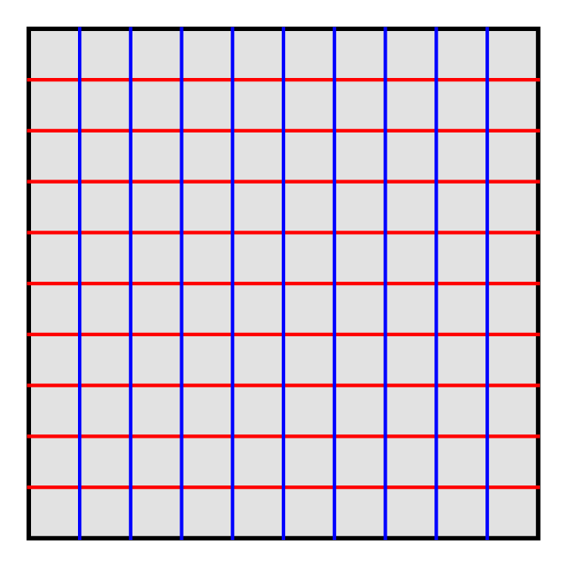
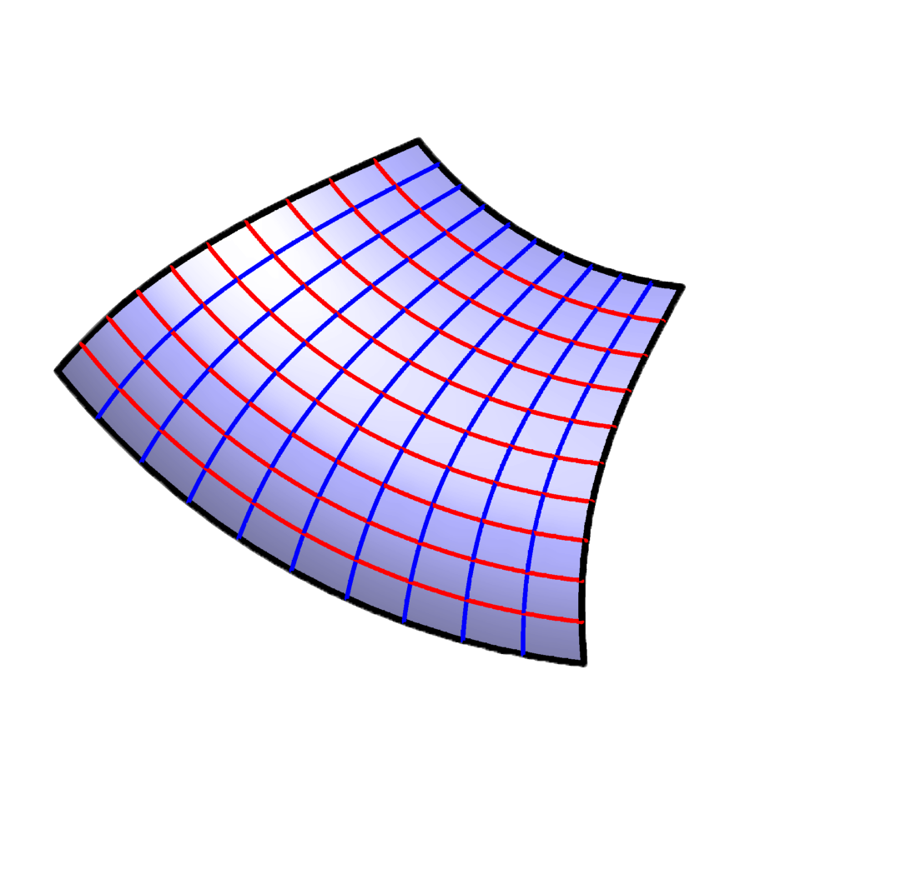
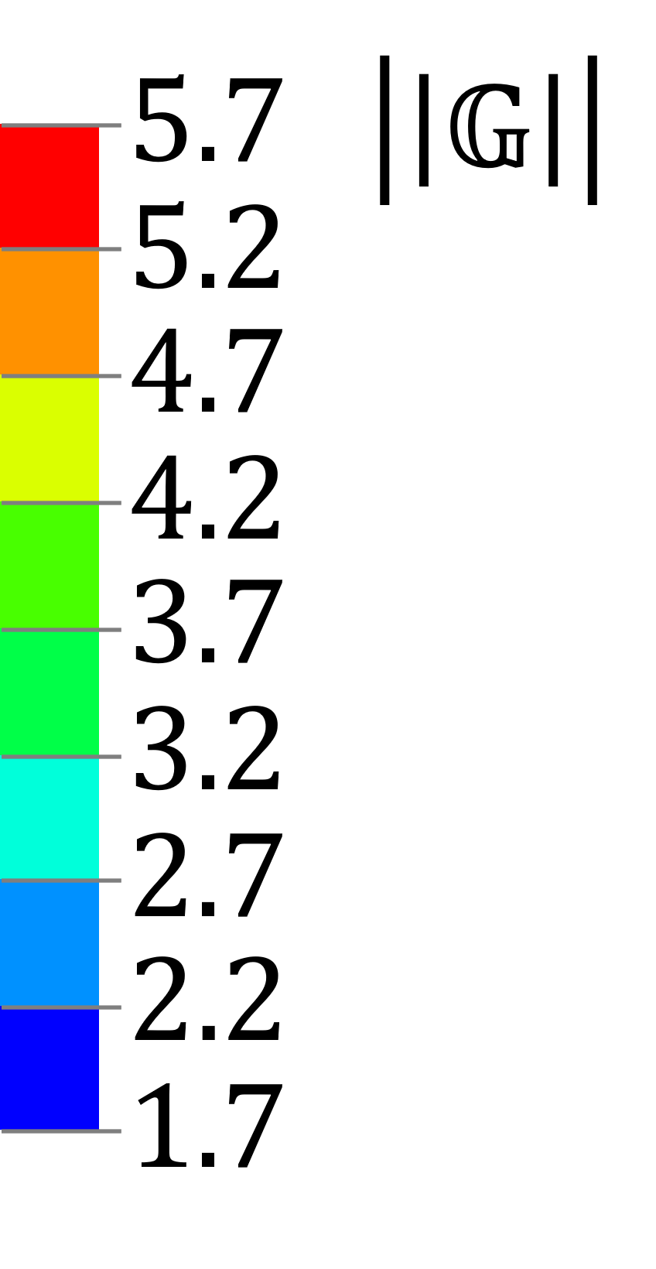
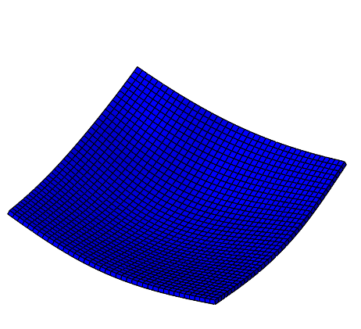
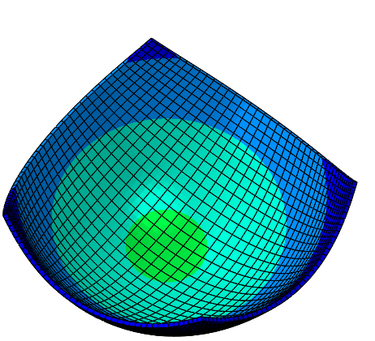
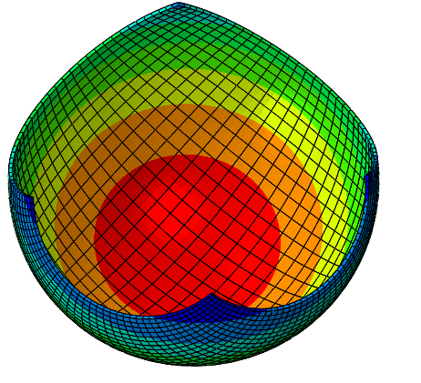
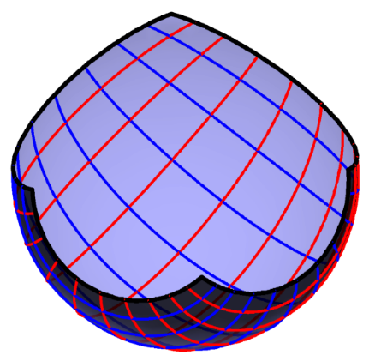
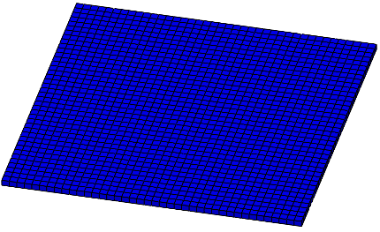

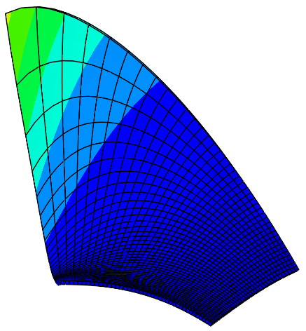
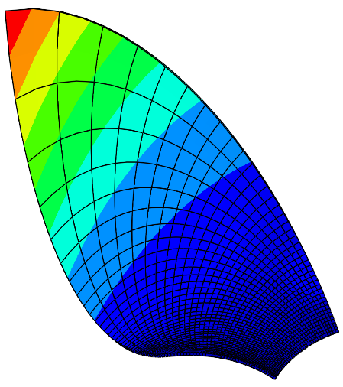
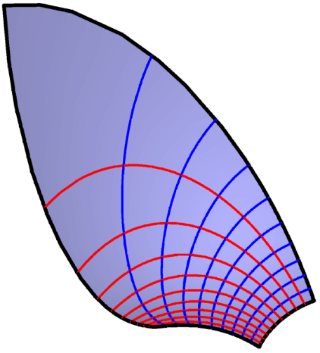
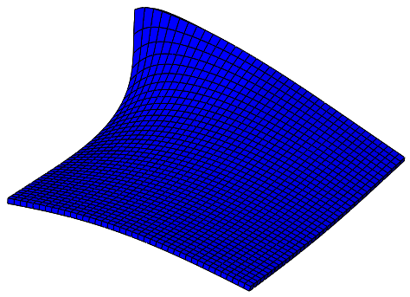

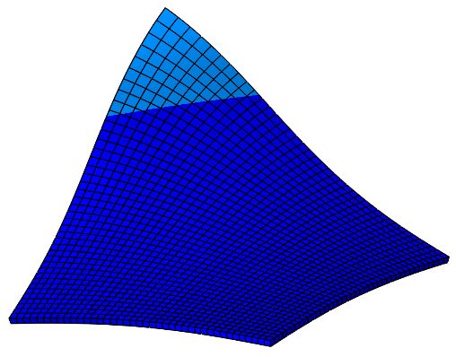
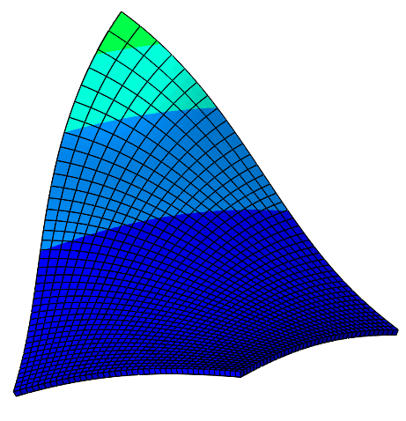
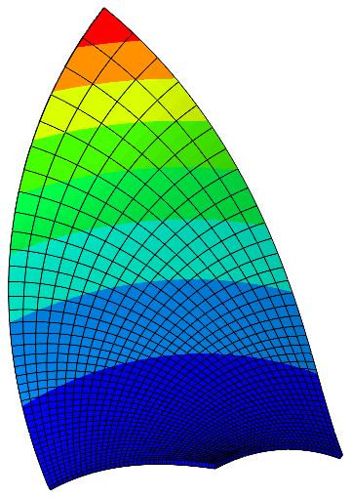
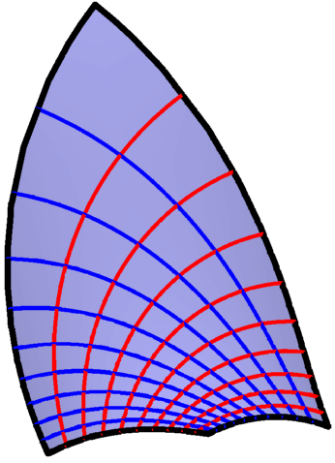
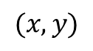
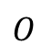
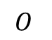
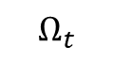
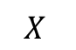
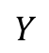
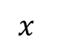
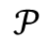
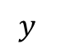
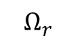
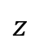
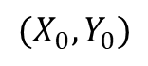
$$Y$$
$$(X_{0},Y_{0})$$
$$z$$
$$(x,y)$$
$$𝒫$$
$$Ω_{r}$$
$$O$$
$$y$$
$$O$$
$$X$$
$$x$$
$$Ω_{t}$$
$$r\left(X,Y\right)=\left\{\frac{4X−2}{W(X,Y)},\frac{4Y−2}{W\left(X,Y\right)},1−\frac{2}{W(X,Y)}\right\}, W\left(X,Y\right)=3+4\left(X−1\right)X+4\left(Y−1\right)Y$$
$$r\left(X,Y\right)=\left\{\frac{X}{2}\left(1−\frac{1}{X^{2}+Y^{2}}\right),\frac{Y}{2}\left(1−\frac{1}{X^{2}+Y^{2}}\right),ArcTan\frac{Y}{X}\right\}$$
$$r\left(X,Y\right)=\left\{\frac{W\left(X,Y\right)+1}{2W\left(X,Y\right)}U\left(X\right), \frac{W\left(X,Y\right)+1}{2W\left(X,Y\right)}V\left(Y\right),ArcCosh\frac{1 +W\left(X,Y\right)}{2\sqrt{W\left(X,Y\right)}}\right\},U\left(X\right)=\frac{X}{2}+\frac{1}{10}, V\left(Y\right)=\frac{Y}{2}+\frac{1}{10}, W\left(X,Y\right)={U\left(X\right)}^{2}+{V\left(Y\right)}^{2}$$
压缩图片

Slide 2
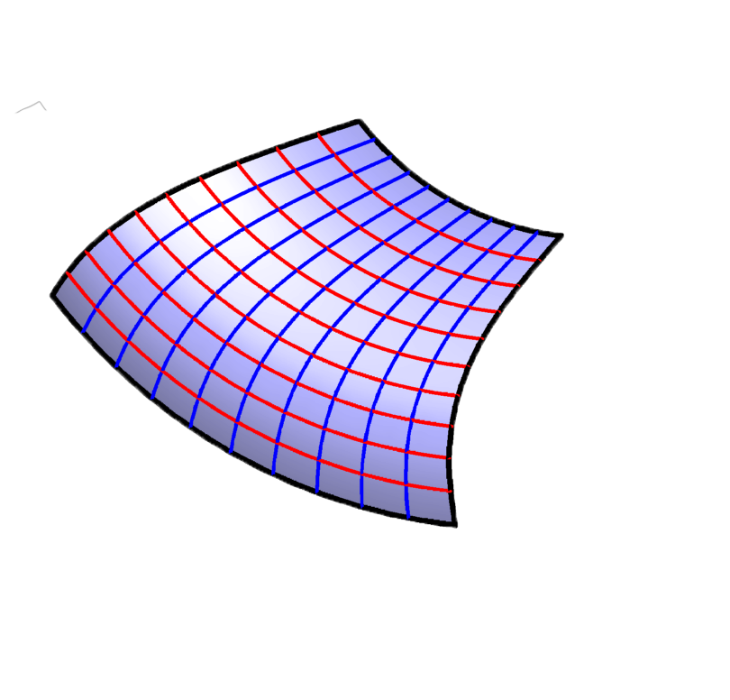
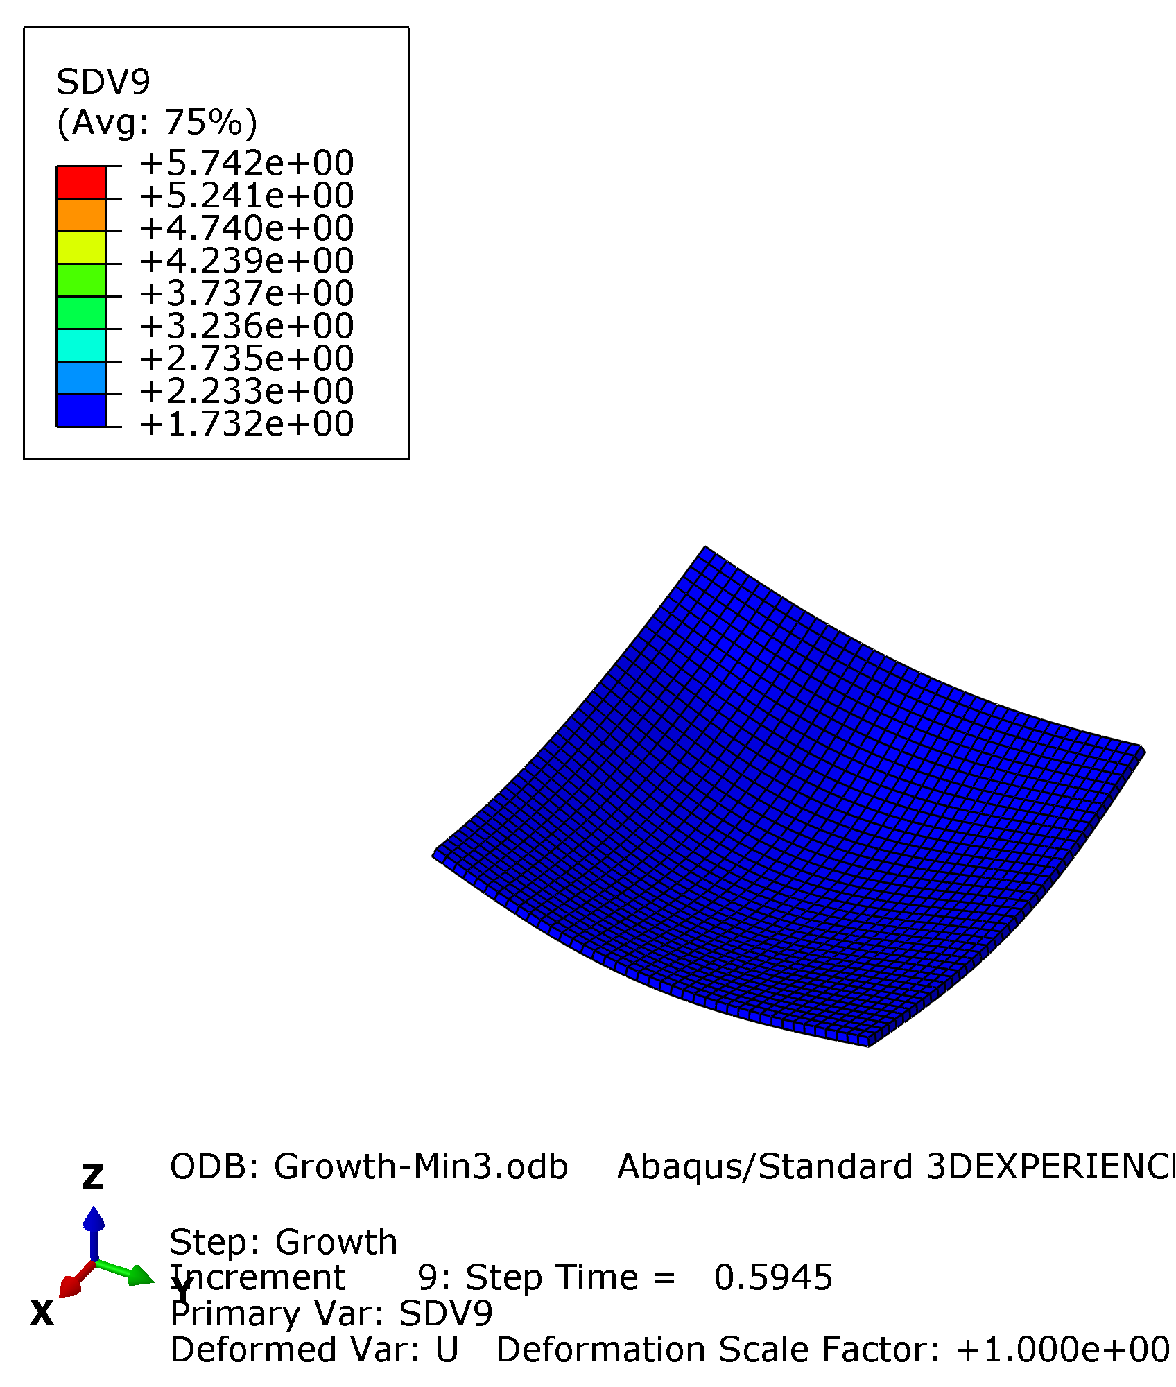
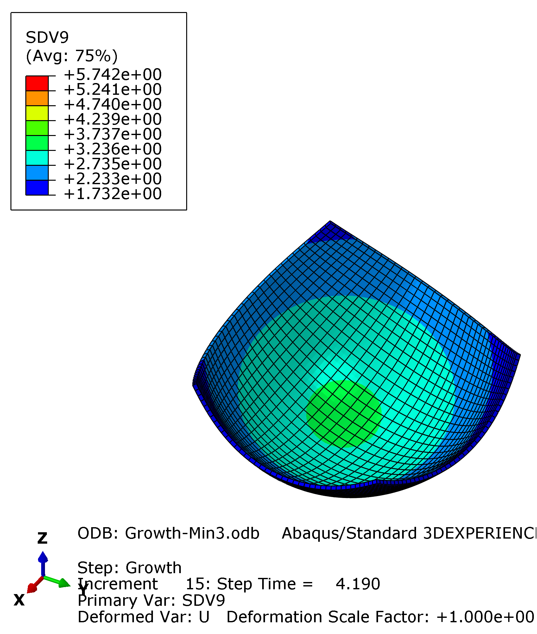
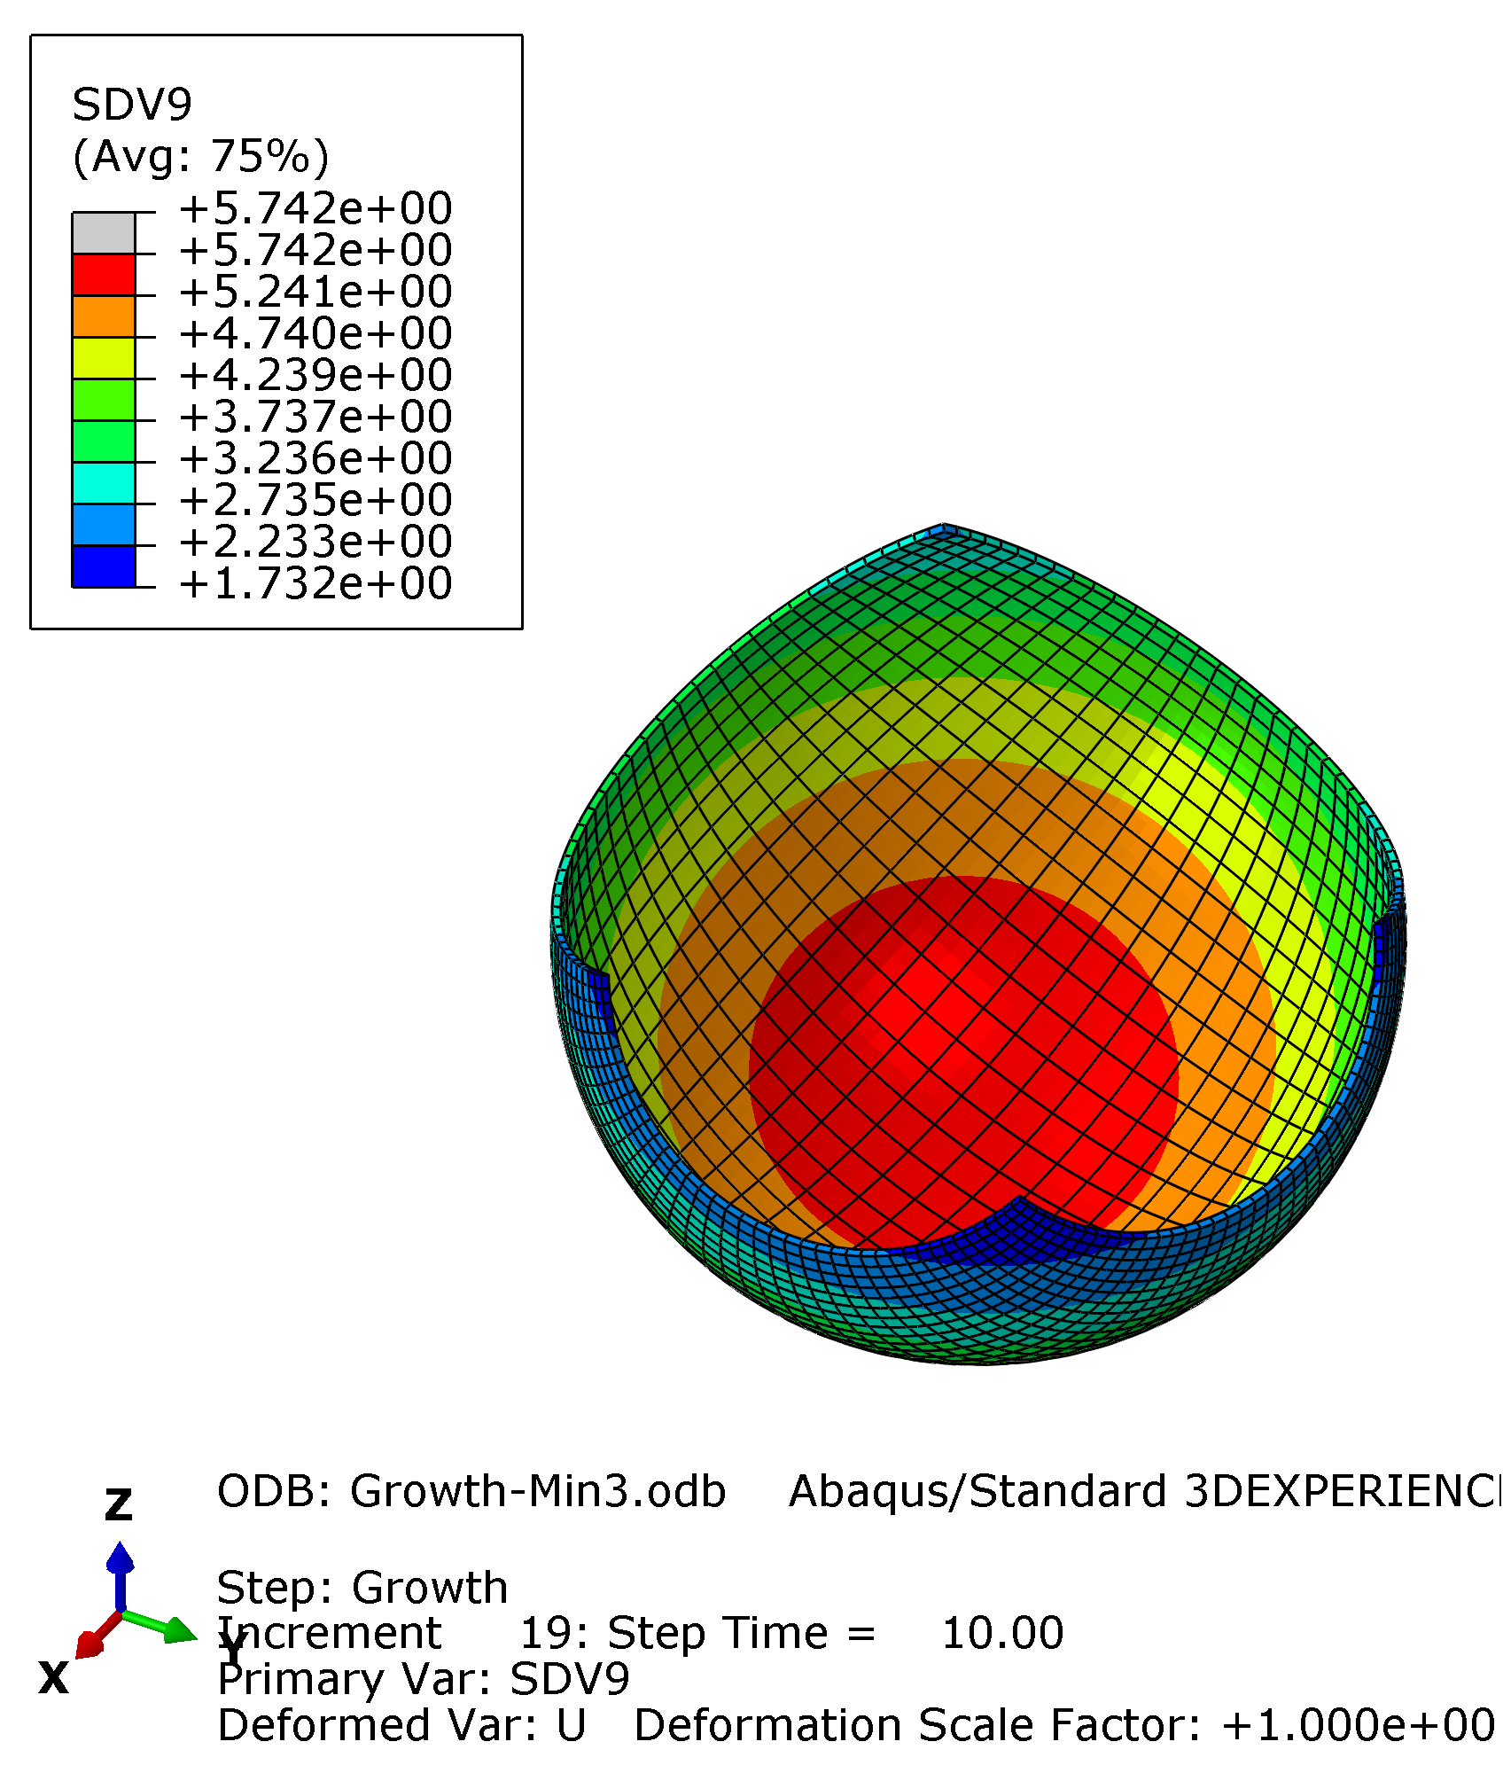
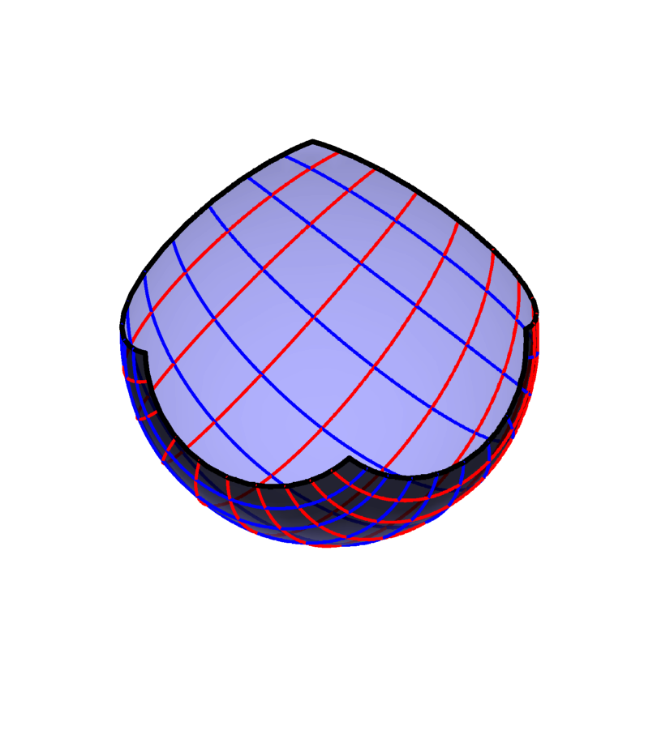
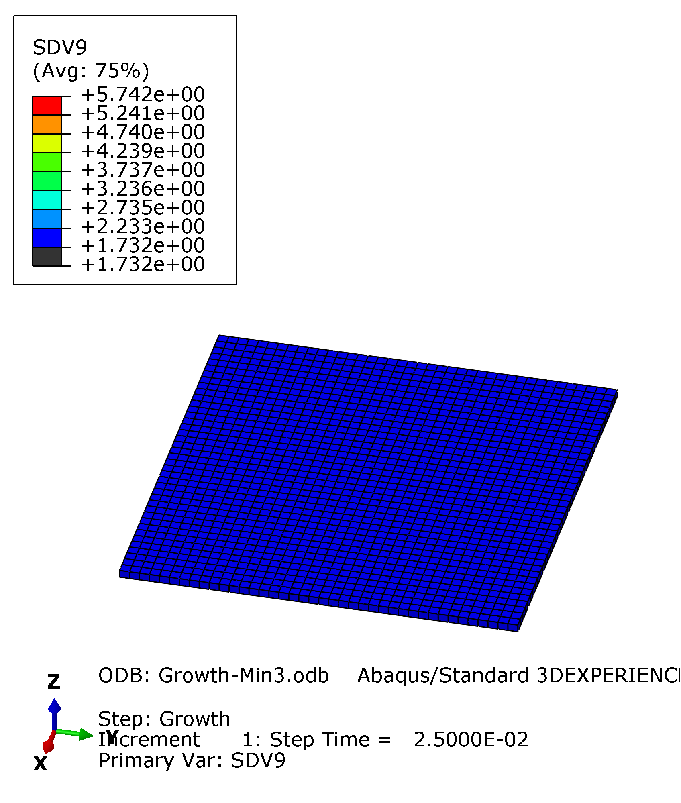
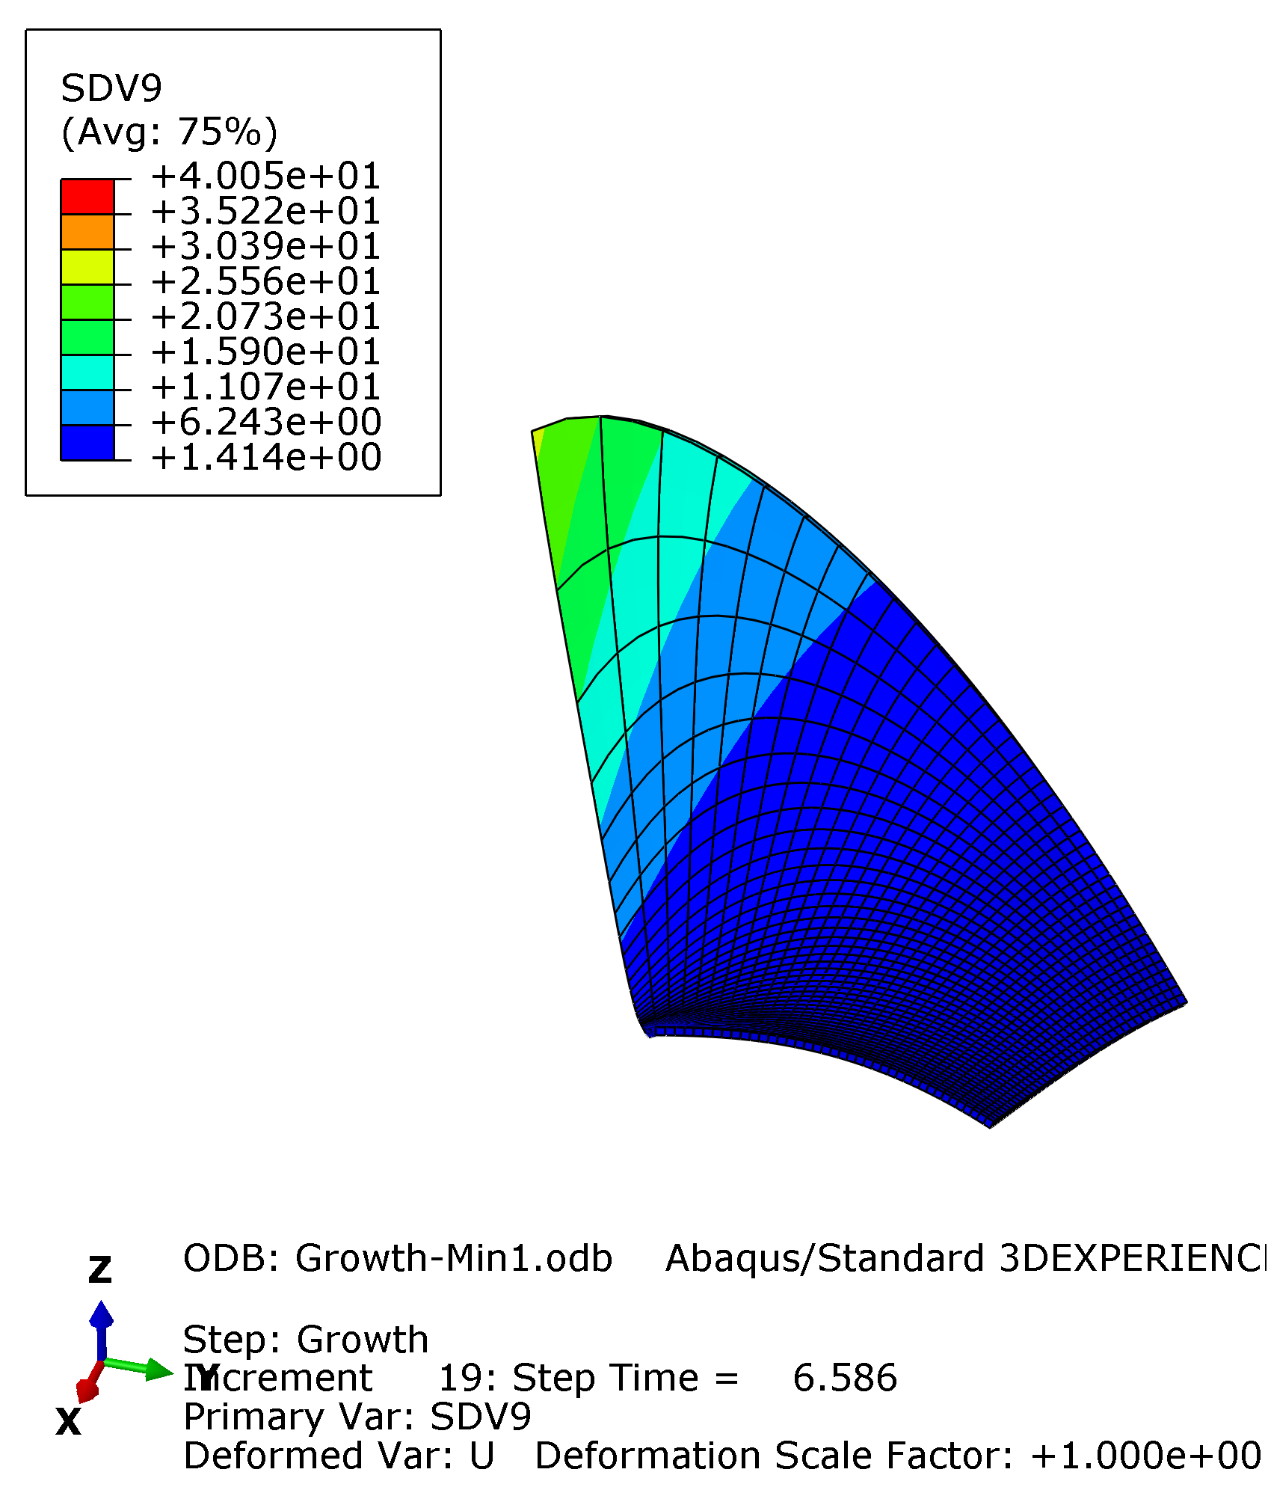
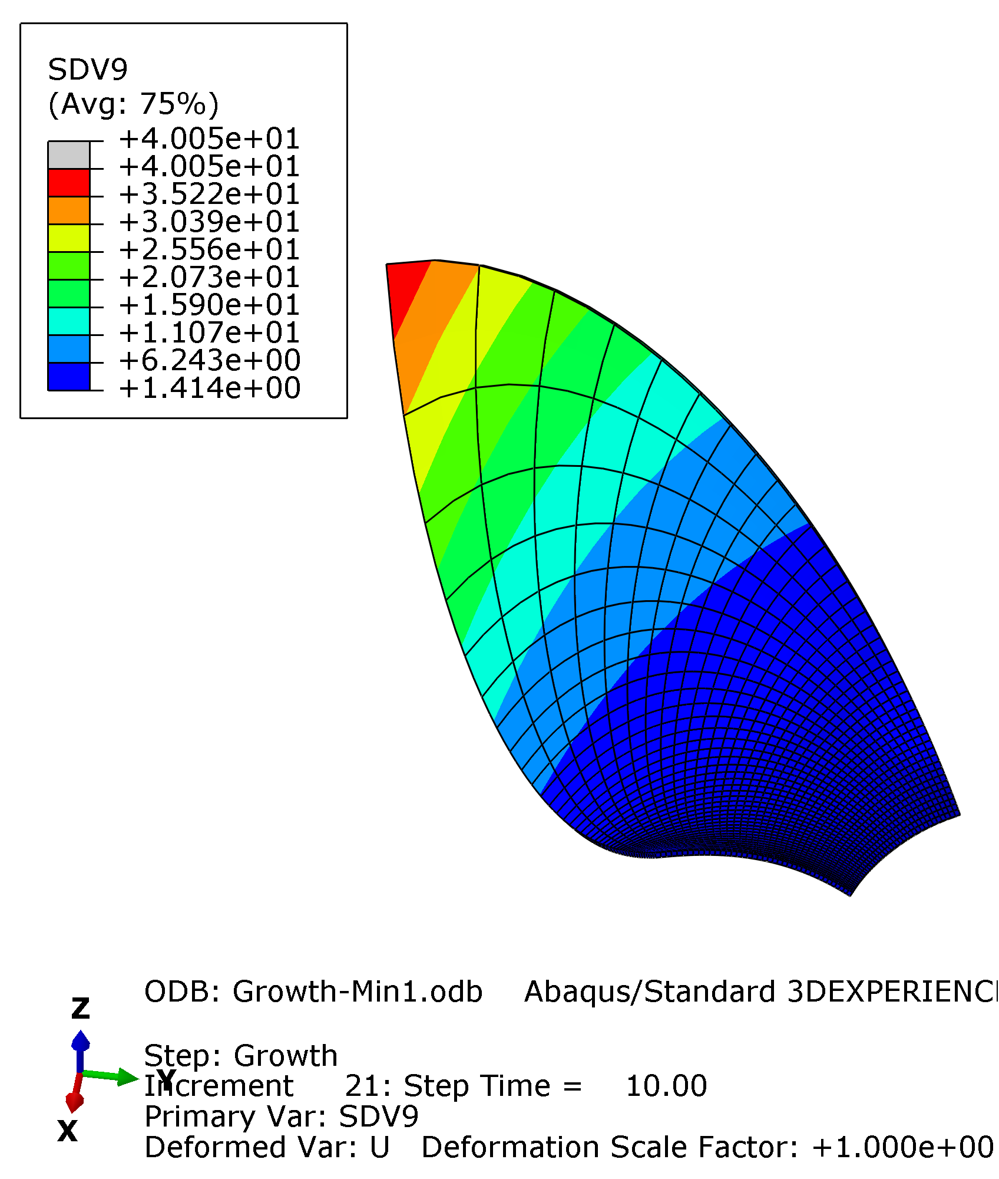
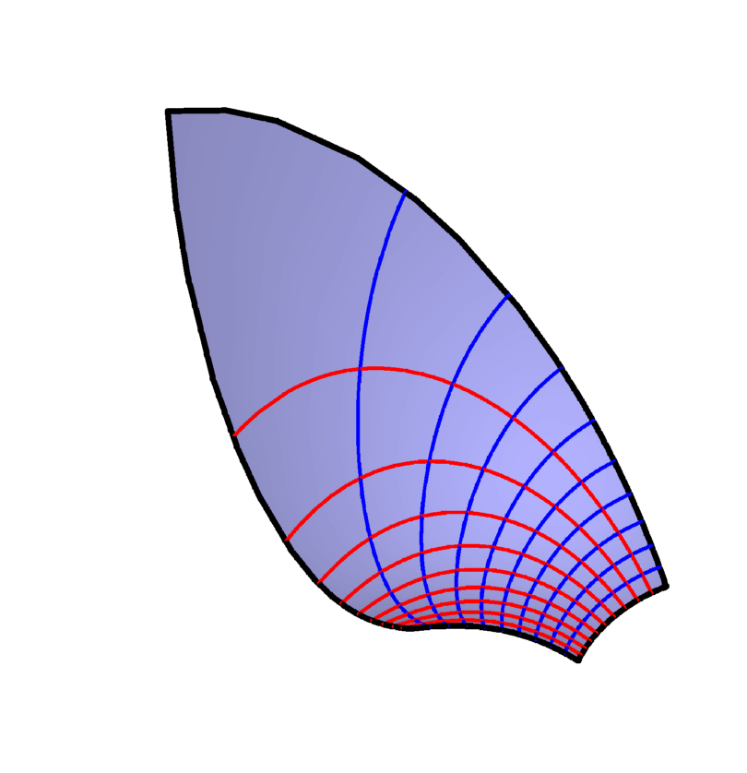
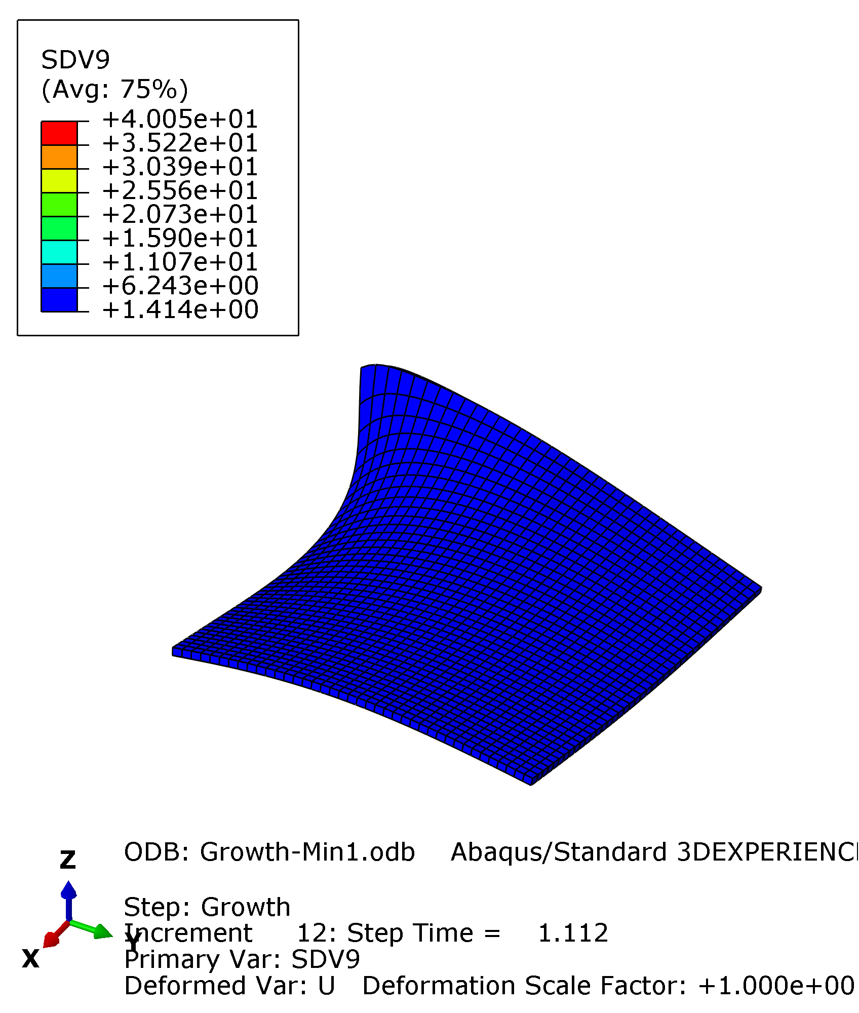
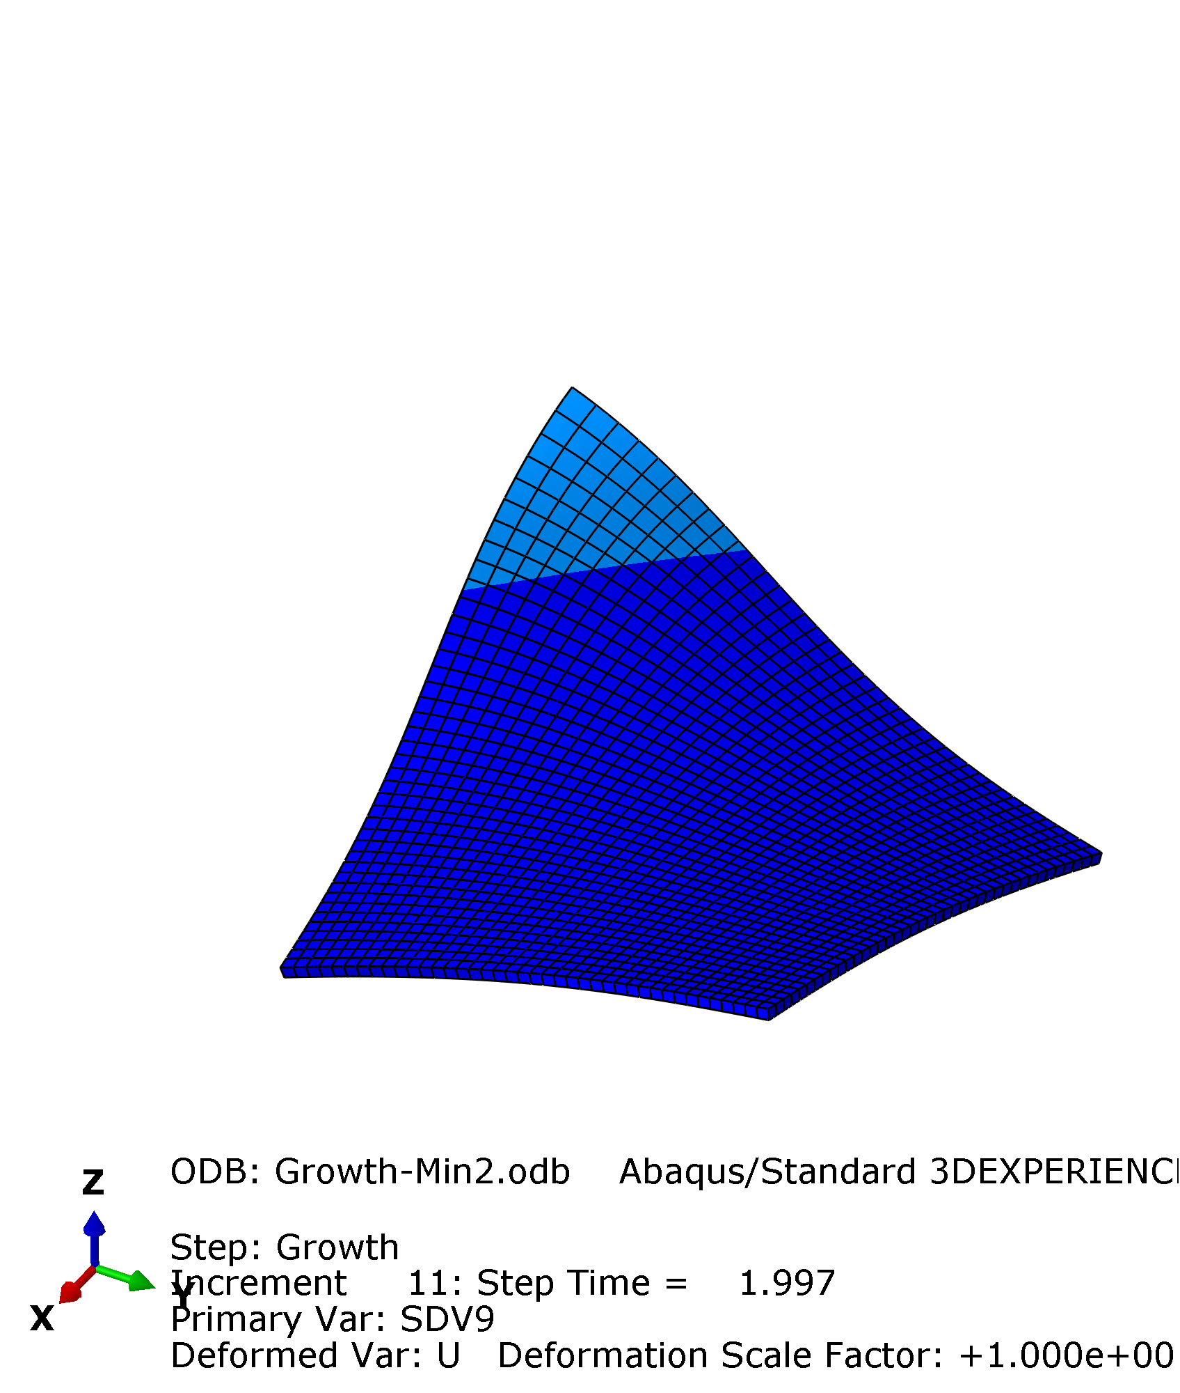
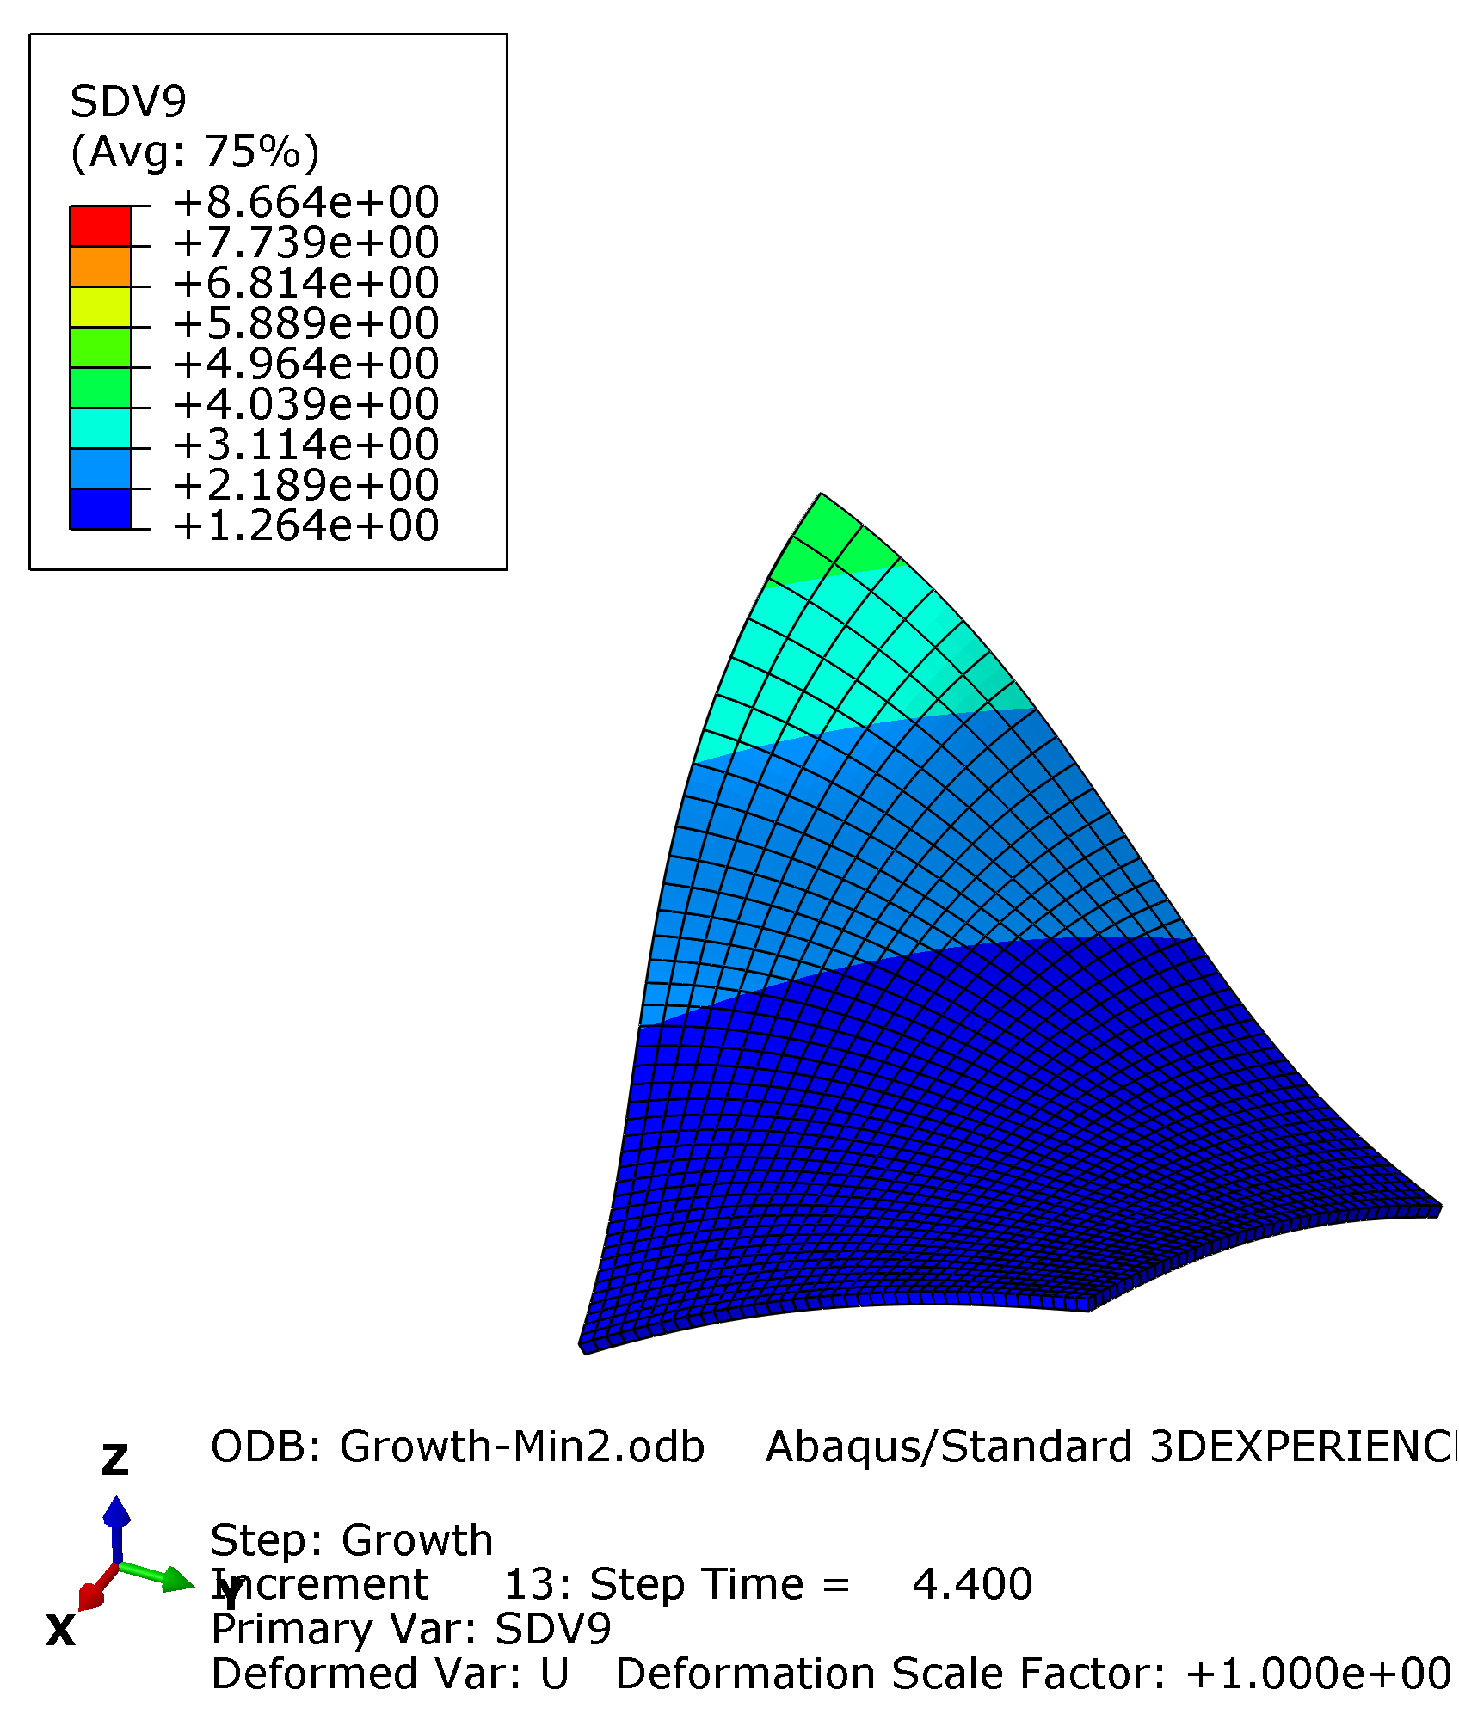
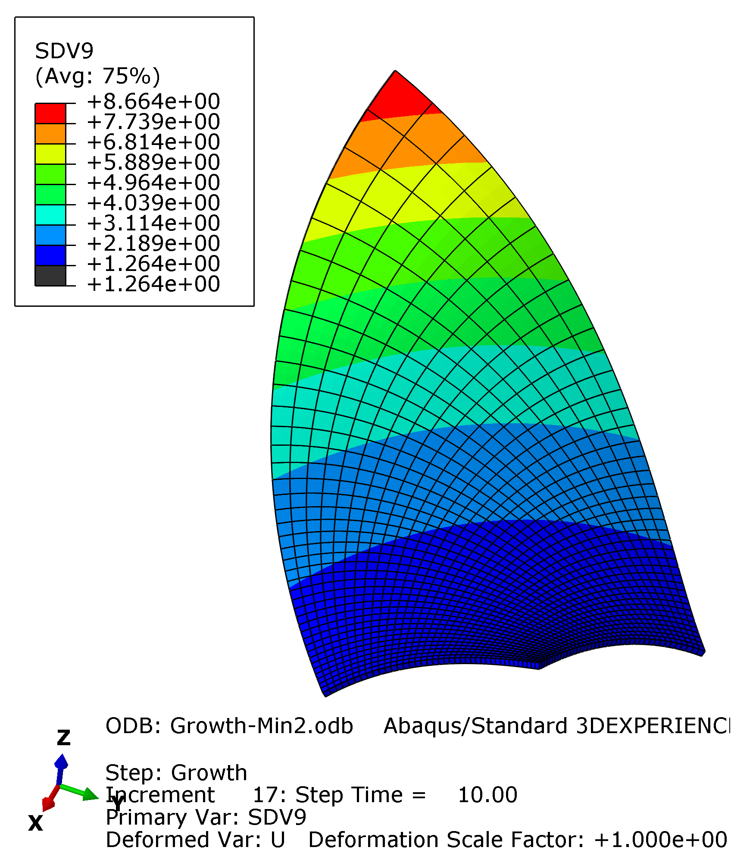
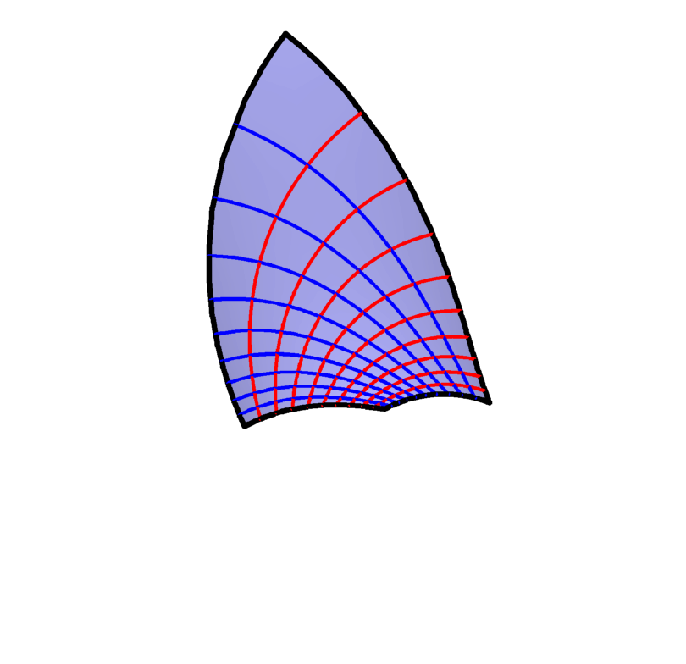
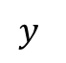
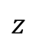
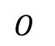
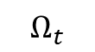
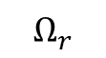
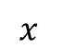
$$Y$$
$$(X_{0},Y_{0})$$
$$z$$
$$(x,y)$$
$$Ω_{r}$$
$$O$$
$$y$$
$$O$$
$$X$$
$$x$$
$$Ω_{t}$$
$$r\left(X,Y\right)=\left\{\frac{4X−2}{W(X,Y)},\frac{4Y−2}{W\left(X,Y\right)},1−\frac{2}{W(X,Y)}\right\}, W\left(X,Y\right)=3+4\left(X−1\right)X+4\left(Y−1\right)Y$$
$$r\left(X,Y\right)=\left\{\frac{X}{2}\left(1−\frac{1}{X^{2}+Y^{2}}\right),\frac{Y}{2}\left(1−\frac{1}{X^{2}+Y^{2}}\right),ArcTan\frac{Y}{X}\right\}$$
$$r\left(X,Y\right)=\left\{\frac{W\left(X,Y\right)+1}{2W\left(X,Y\right)}U\left(X\right), \frac{W\left(X,Y\right)+1}{2W\left(X,Y\right)}V\left(Y\right),ArcCosh\frac{1 +W\left(X,Y\right)}{2\sqrt{W\left(X,Y\right)}}\right\},U\left(X\right)=\frac{X}{2}+\frac{1}{10}, V\left(Y\right)=\frac{Y}{2}+\frac{1}{10}, W\left(X,Y\right)={U\left(X\right)}^{2}+{V\left(Y\right)}^{2}$$
这些曲面看起来太简单了，要不要换成圆环？

Slide 3
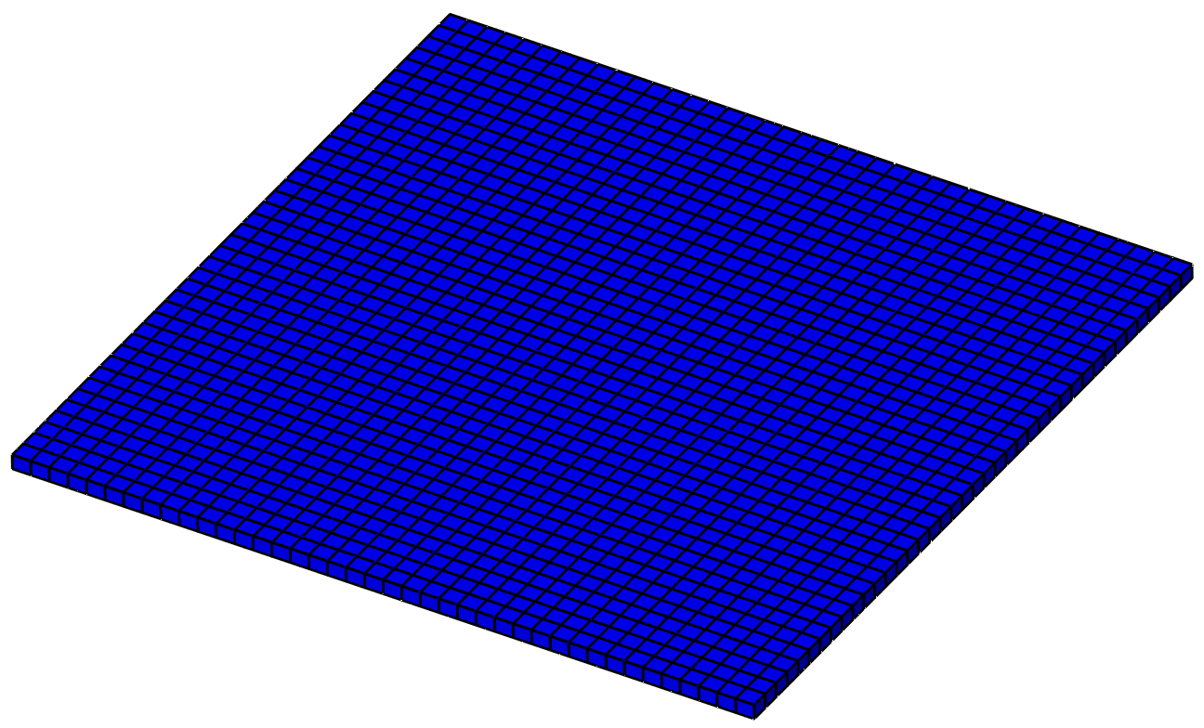
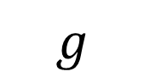
$$g$$
40
35
30
26
21
16
11
6.2
1.4
Min1 heli

Slide 4

$$g$$
8.7
7.7
6.8
5.9
4.9
4.0
3.1
2.2
1.3
Min2 Cater

Slide 5
$$g$$
5.7
5.2
4.7
4.2
3.7
3.2
2.7
2.2
1.7
Min2 Sphere

